Slide 1
VFR Flight Conditions
Ocdt Wu
1 Oct 2019

Slide 2
Terminology
Minimum Conditions in Controlled Airspace
Minimum Conditions in Uncontrolled Airspace
Day VFR instruments

Slide 3
Visual Flight Rules (VFR):
The rules which apply when flying by means of visual reference to the ground

Slide 4
Instrument Flight Rules (IFR):
The rules which apply when flying by means of reference to the instruments in the cockpit
Special VFR:
The rules for operating in weather conditions that are less than VFR within a control zone where some aircraft are permitted flight under visual flight rules

Slide 5
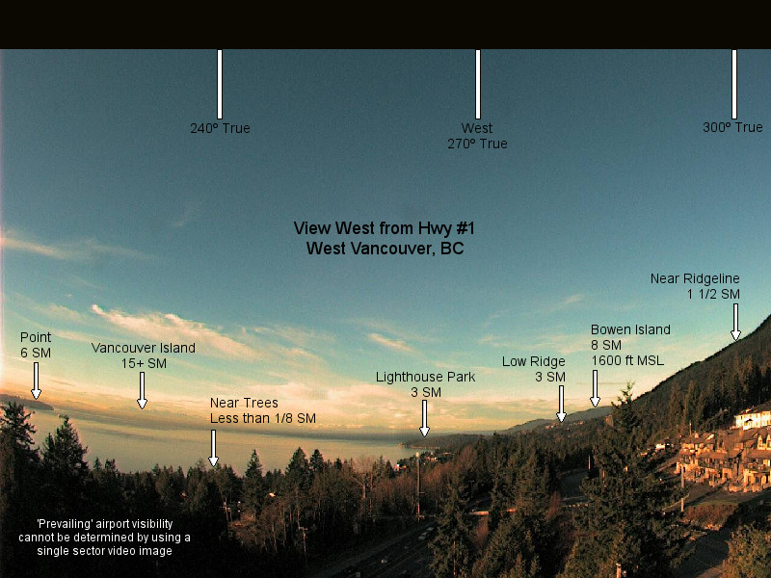
Visibility
The ability, as determined by atmospheric conditions and expressed in units of distance, to see and identify prominent unlighted objects by day and prominent lighted objects by night

Slide 6
Ceiling:
The lowest height at which a broken or overcast condition exists; or…
The vertical visibility when an obscured condition such as snow, smoke, or fog exists (500’ in this example)

Slide 7
Day:
The time between the beginning of morning civil twilight and the end of evening civil twilight
Night:
the time between the end of evening civil twilight and the beginning of morning civil twilight

Slide 8
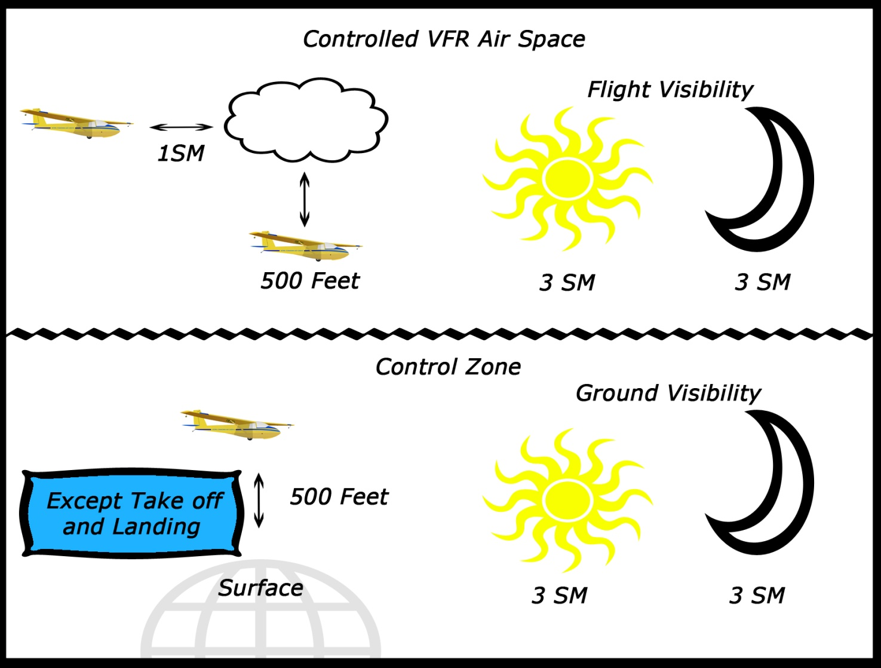

Slide 9
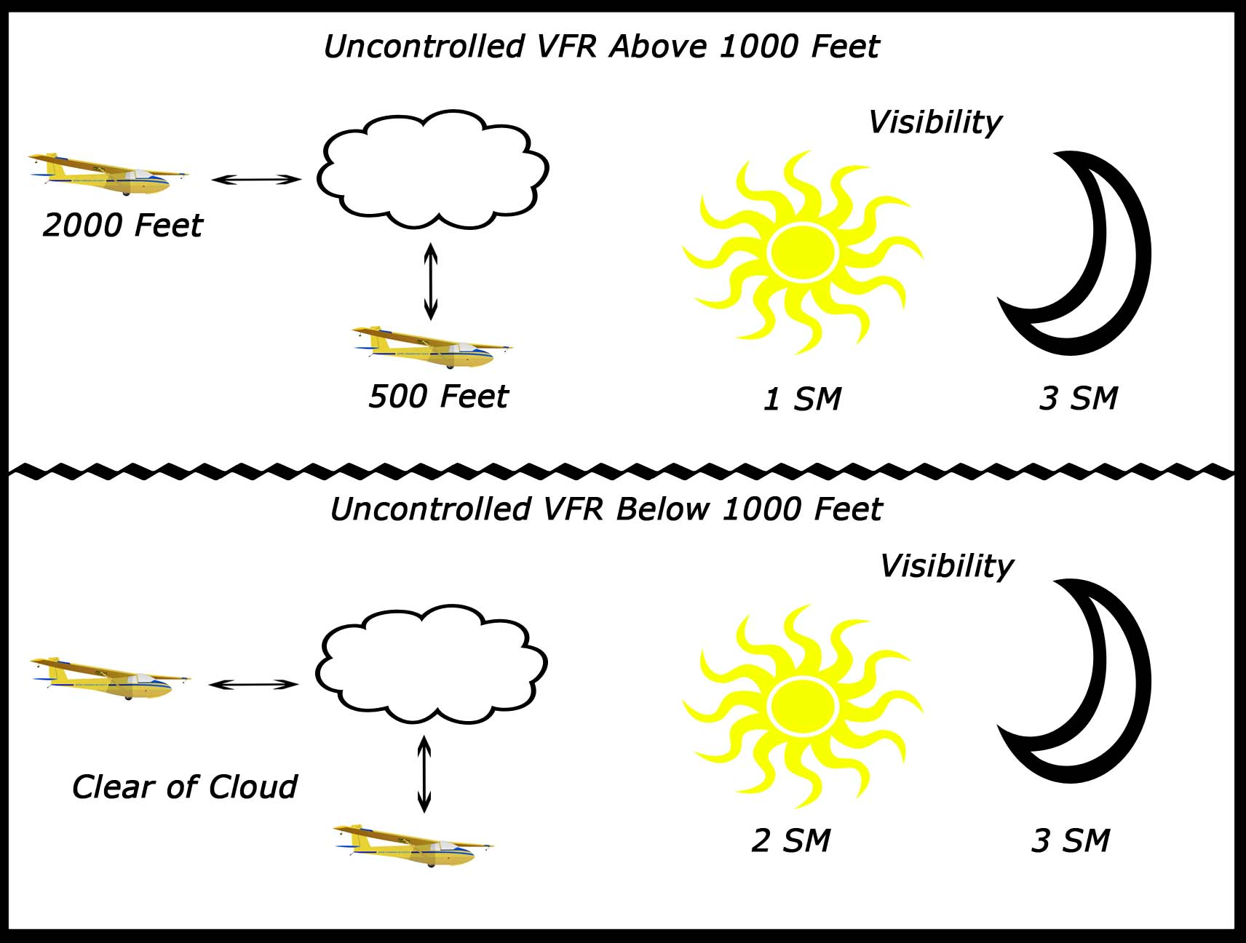

Slide 10
Memory Tool (For daytime) – just remember the numbers
3 1 5 : In a control zone
3sm visibility, 1sm from cloud, 500’ above/below cloud
1 2 5 : Uncontrolled Above 1000’
1sm visibility, 2000’ from cloud, 500’ above/below cloud
2 C : Uncontrolled Below 1000’
2sm visibility, remain clear of cloud

Slide 11
No person shall operate a glider in day VFR flight unless it is equipped with:
Altimeter
Airspeed indicator
Magnetic compass or magnetic direction indicator
Two-way radio with selectable frequency (if in controlled airspace)

